Slide 1

Monero’s Release Schedule: We Can Do Better
Justin Ehrenhofer
DV Trading / DV Chain
Community Workgroup Organizer

Slide 2

High-Level Takeaways
Monero’s release schedule is usually nothing short of chaos
Updates are fine, but we need to get our act together
Effort isn’t typically the issue
We need to be better at communication
Monero’s Release Schedule: We Can Do Better - Justin Ehrenhofer
DEFCON 2019

Slide 3
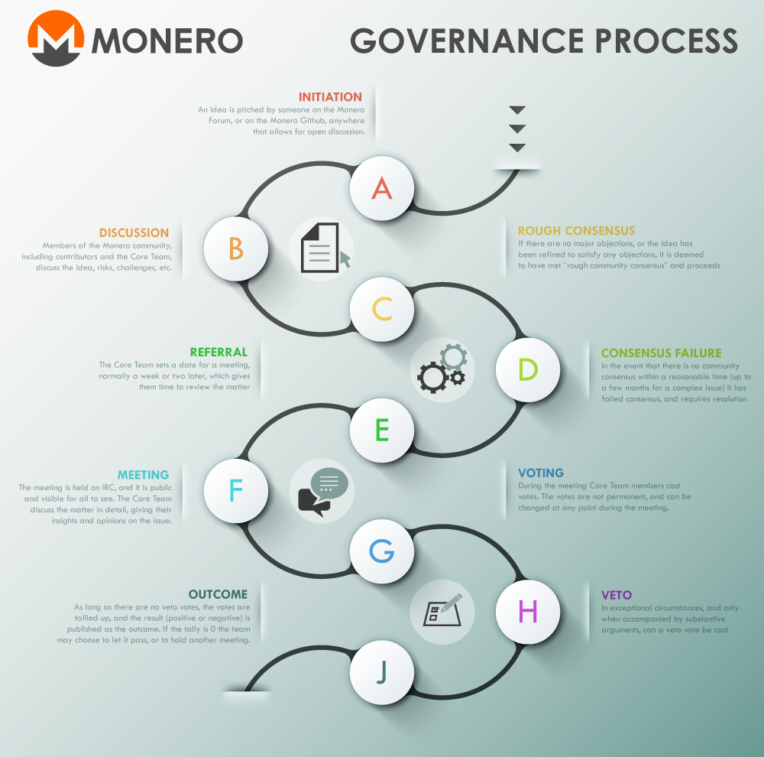
What Monero Supposedly Does
Taken from the 2015 Year in Review
Monero’s Release Schedule: We Can Do Better - Justin Ehrenhofer
DEFCON 2019

Slide 4
Case Study I: Spring 2019 Update
Core Team Decision to Update Early
February 10
Early Update Date
March 9
Original Planned Update Date
~April 9
0.14.1 Release
July 17
0.14 Release
February 25
Monero’s Release Schedule: We Can Do Better - Justin Ehrenhofer
DEFCON 2019

Slide 5
Case Study I: Spring 2019 Update
Core Team Decision to Update Early
February 10
Early Update Date
March 9
Original Planned Update Date
~April 9
0.14.1 Release
July 17
0.14 Release
February 25
Moving the release forward one month delayed the implementation of most features by three months.
Monero’s Release Schedule: We Can Do Better - Justin Ehrenhofer
DEFCON 2019

Slide 6
Case Study II: Payment IDs
Opened Discussion
May 2018
Payment ID Meeting
January 2019
“Long Payment ID Deprecation” Blog Post
June 2019
0.15 Release
October 2019
Ongoing Discussion
Monero’s Release Schedule: We Can Do Better - Justin Ehrenhofer
DEFCON 2019

Slide 7
Case Study II: Payment IDs
Everyone agreed that using long payment IDs is bad
Only some people argued for the removal of short payment IDs
No one agreed on what “deprecation” meant – wallet or consensus?
No one agreed on how to deprecate – permanent or temporary?
Monero’s Release Schedule: We Can Do Better - Justin Ehrenhofer
DEFCON 2019

Slide 8
Areas of Success
Monero has a strong decentralized passion. It’s unlikely that controversial changes can be implemented without significant prior discussion.
Monero has a huge community of people who genuinely care. They offer many perspectives with good intentions.
The Monero community continues to grow.
Monero’s Release Schedule: We Can Do Better - Justin Ehrenhofer
DEFCON 2019

Slide 9
Room for Improvement
Monero doesn’t have enough code reviewers.
Monero Core Team is a bottleneck.
More formal proposal processes and distilled discussions are needed.
Better stakeholder notifications are essential for feedback and communicating timelines.
Monero needs to commit to many (not all) changes in advance.
Monero’s Release Schedule: We Can Do Better - Justin Ehrenhofer
DEFCON 2019

Slide 10
What Are We Doing?
Github issues and pull requests
Developer, Community, MRL meetings
Reddit discussions
IRC discussions
Monero’s Release Schedule: We Can Do Better - Justin Ehrenhofer
DEFCON 2019

Slide 11
What Are We Doing?
Github issues and pull requests
Developer, Community, MRL meetings
Reddit discussions
IRC discussions
A chaotic, hands-off decision-making process is MORE centralized than a clear, formal process
Monero’s Release Schedule: We Can Do Better - Justin Ehrenhofer
DEFCON 2019

Slide 12
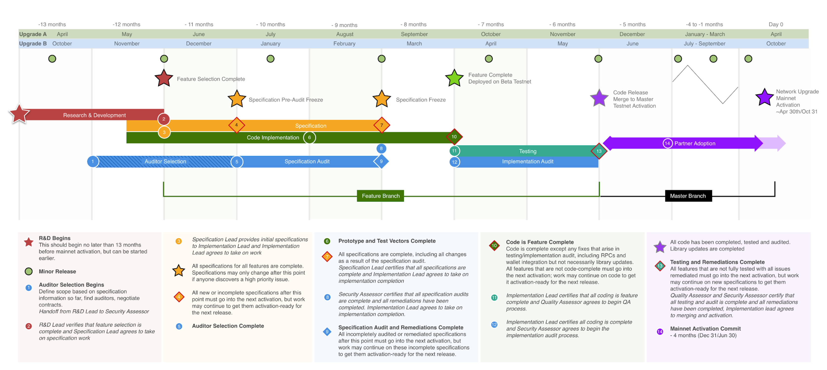
What Are Others Doing? - Zcash
https://electriccoin.co/blog/the-zcash-network-upgrade-pipeline
-13 months
-8 months
Specification Freeze
Monero’s Release Schedule: We Can Do Better - Justin Ehrenhofer
DEFCON 2019

Slide 13
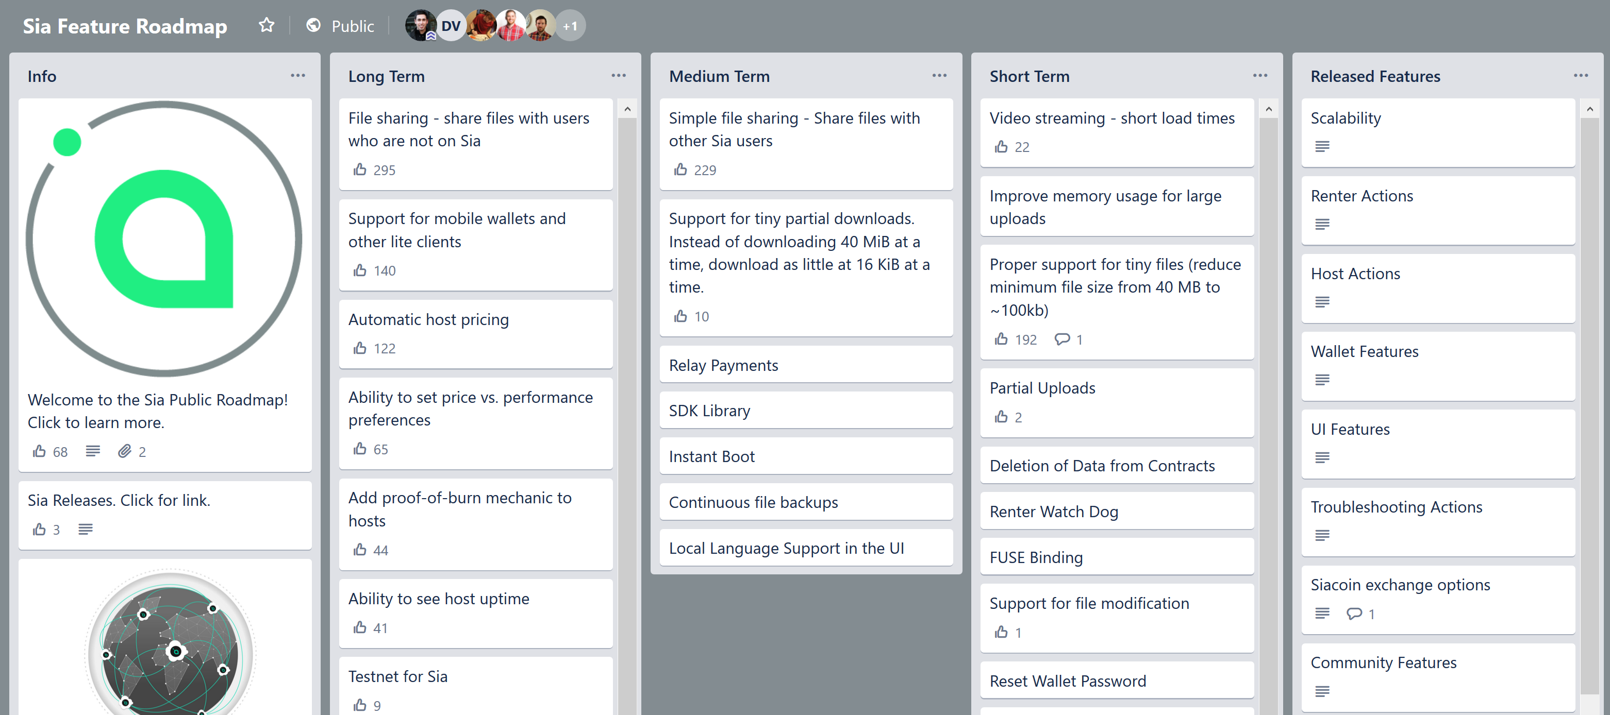
What Are Others Doing? - Sia
Monero’s Release Schedule: We Can Do Better - Justin Ehrenhofer
DEFCON 2019

Slide 14
Formalized Processes ≠ Centralization
By adopting more formal processes, Monero can:
Provide more clarity in the decision-making process
Engage a wider set of stakeholders
More clearly communicate changes in advance to important ecosystem components
Reduce Core Team influence by giving others a clear platform
Offer better, less chaotic release schedules
Agreeing to a sensible formal process increases decentralization overall and brings large benefits.
Monero’s Release Schedule: We Can Do Better - Justin Ehrenhofer
DEFCON 2019

Slide 15
What I Don’t Propose
Voting for specific proposals – too easy to manipulate and subject to other issues
Delaying critical security patches
Upgrading at an unnecessarily high, burdensome frequency
Asking the Core Team to completely run this process
…but they need to be a part of it! Their buy-in is key!
Monero’s Release Schedule: We Can Do Better - Justin Ehrenhofer
DEFCON 2019

Slide 16
The Monero Ecosystem Grows in Complexity
MyMonero
Whonix
Mastering Monero (Lernolibro LLC)
Zcash Foundation
Binance
DV Chain
Morph
Token
Ledger
MAGIC Grants
Tari
Cypher Market
Kraken
Edge
OSTIF
Colorado Crypto Conferences
OpenBazaar
Bisq
Shapeshift
Electric Coin Company
WooKey
Trezor
Blockfolio
Outside Researchers
Purism
Circle / Poloniex
Sweetwater Digital Asset Consulting
Cake Wallet
GloBee
Monerujo
Meetups
Revuo Monero
Monero Malware Response Workgroup
Monero RU
Monero Trading Community
Monero CCC Workgroup
Monero Localization Workgroup
Monero GUI Workgroup
Monero Developer Workgroup
CoinDesk & Other News
Monero Community Workgroup
Monero Support Workgroup
Monero Mining Community
Monero Ecosystem Workgroup
Monero Defcon Workgroup
RIAT
Monero
Core Team
Coin Center
Monero Talk
Monero Hardware Workgroup
Monero Outreach Workgroup
Monero Research Lab
Monero’s Release Schedule: We Can Do Better - Justin Ehrenhofer
DEFCON 2019

Slide 17
The Monero Ecosystem Grows in Complexity
MyMonero
Whonix
Mastering Monero (Lernolibro LLC)
Zcash Foundation
Binance
DV Chain
Morph
Token
Ledger
MAGIC Grants
Tari
Cypher Market
Kraken
Edge
OSTIF
Colorado Crypto Conferences
OpenBazaar
Bisq
Shapeshift
Electric Coin Company
WooKey
Trezor
Blockfolio
Outside Researchers
Purism
Circle / Poloniex
Sweetwater Digital Asset Consulting
Cake Wallet
GloBee
Monerujo
Meetups
Revuo Monero
Monero Malware Response Workgroup
Monero RU
Monero Trading Community
Monero CCC Workgroup
Monero Localization Workgroup
Monero GUI Workgroup
Monero Developer Workgroup
CoinDesk & Other News
Monero Community Workgroup
Monero Support Workgroup
Monero Mining Community
Monero Ecosystem Workgroup
Monero Defcon Workgroup
RIAT
Monero
Core Team
Coin Center
Monero Talk
Monero Hardware Workgroup
Monero Outreach Workgroup
Monero Research Lab
Monero’s Release Schedule: We Can Do Better - Justin Ehrenhofer
DEFCON 2019

Slide 18
The Monero Ecosystem Grows in Complexity
With such a diverse set of stakeholders, the Core Team & community need to embrace formalization
There is no way to keep track of thousands of conversations and dozens of workgroups
Delegate this task as needed to other workgroups sensibly
Some bureaucracy is good if it gets everyone on the same page
Core Team needs to embrace responsibilities or delegate/abdicate
Smart communication is key
Monero’s Release Schedule: We Can Do Better - Justin Ehrenhofer
DEFCON 2019

Slide 19
Specific Baby Steps
Commit to code freezes one full month before
Decide on the main features about 6 months before scheduled upgrades
More frequent and scheduled minor, feature updates (reproduceable builds, yay!)
Create timelines for major features
Have formal feedback submission procedures for large changes and open conversations to discuss these
Set and adhere to reasonable deadlines, and only adjust if the situation changes
Monero’s Release Schedule: We Can Do Better - Justin Ehrenhofer
DEFCON 2019

Slide 20
Specific Baby Steps
Plans may change, but we need to make them and communicate them clearly
Commit to code freezes one full month before
Decide on the main features about 6 months before scheduled upgrades
More frequent and scheduled minor, feature updates (reproduceable builds, yay!)
Create timelines for major features
Have formal feedback submission procedures for large changes and open conversations to discuss these
Set and adhere to reasonable deadlines, and only adjust if the situation changes
Monero’s Release Schedule: We Can Do Better - Justin Ehrenhofer
DEFCON 2019

Slide 21
Thank You
justin@ehrenhofer.org
#monero-community
r/MoneroCommunity
Monero’s Release Schedule: We Can Do Better - Justin Ehrenhofer
DEFCON 2019

